Slide 1


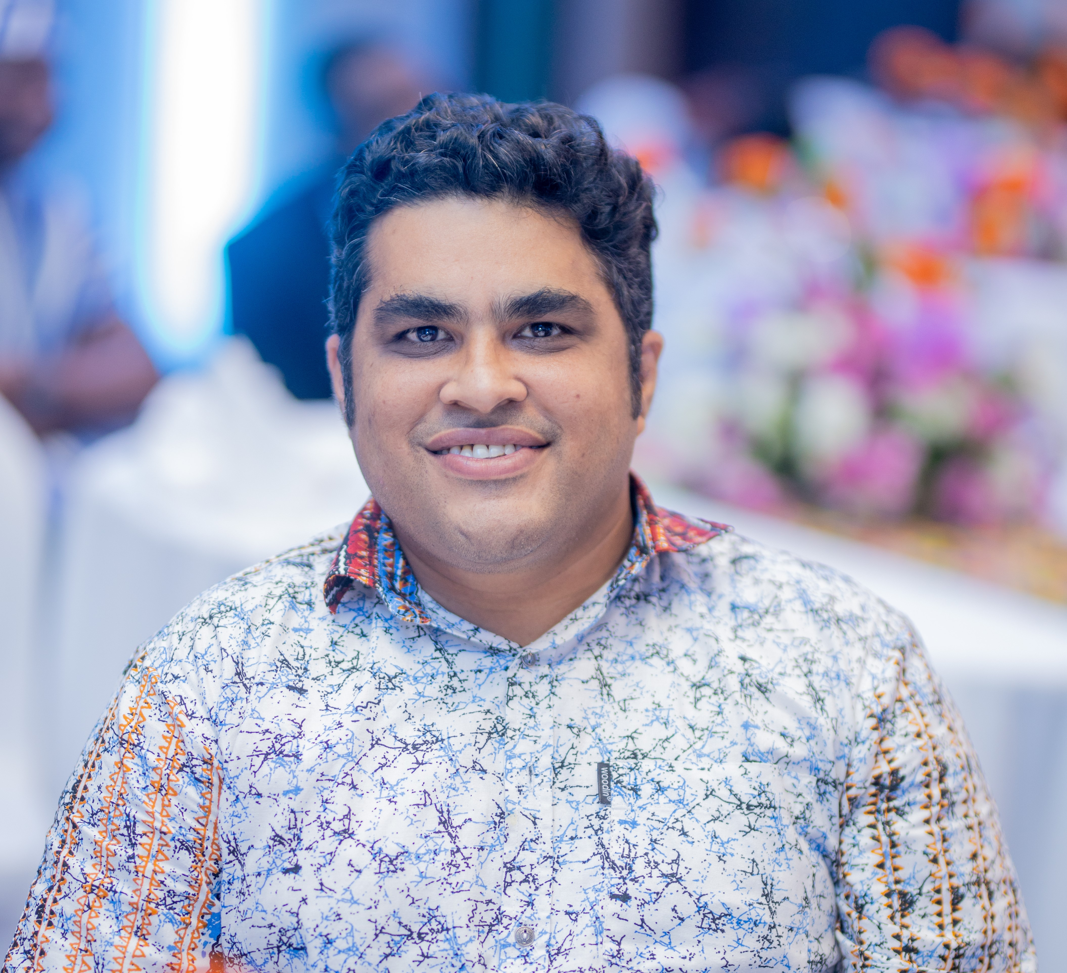
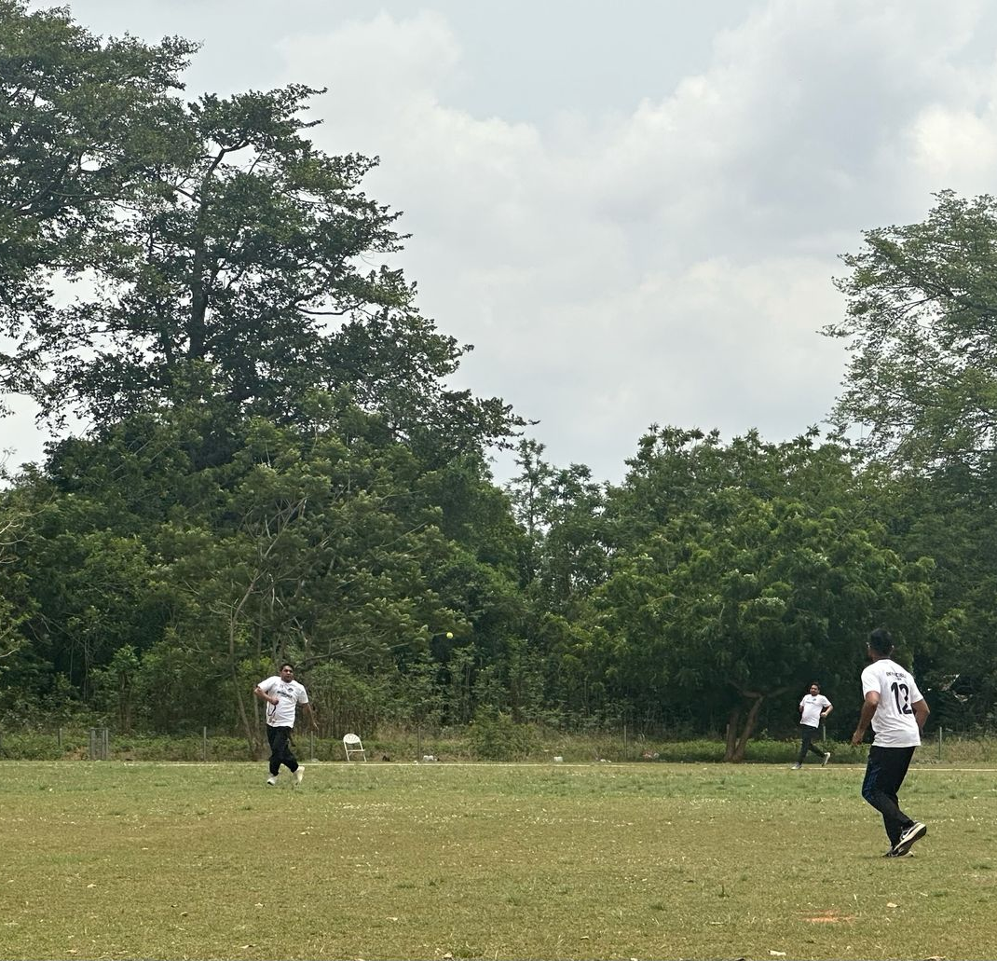
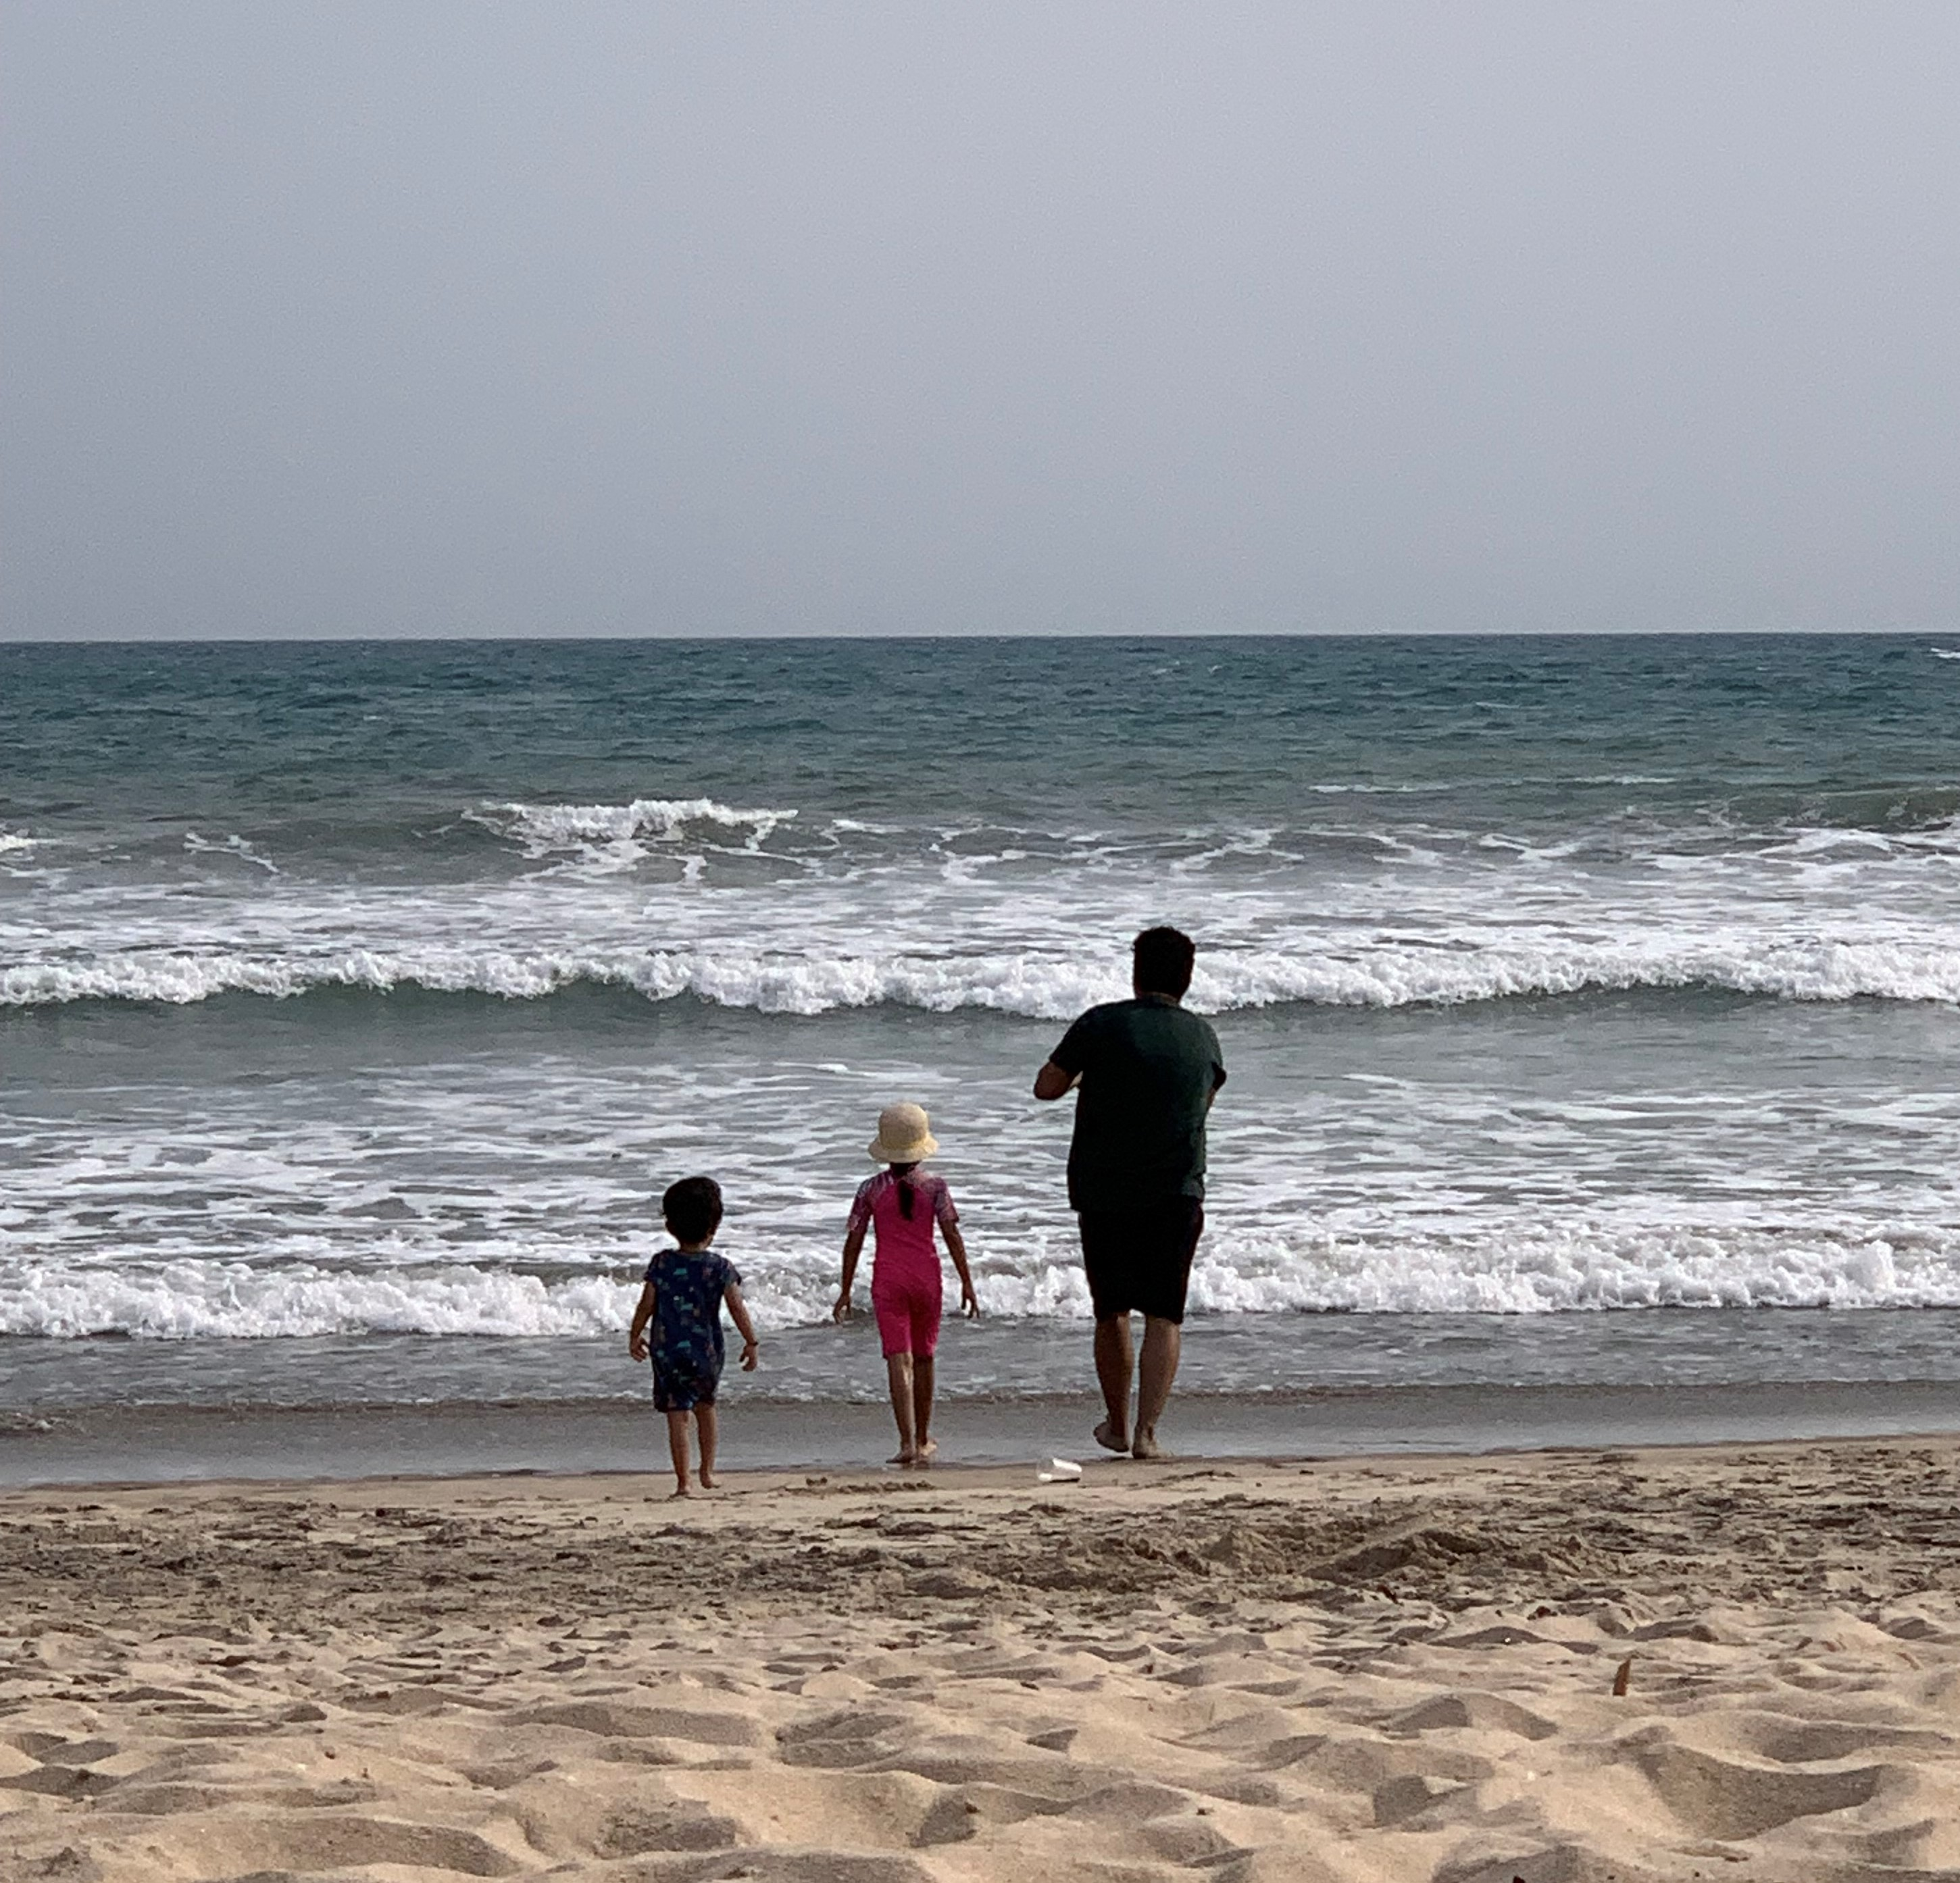
Getting to Know Me
Work
Personal
My role
Finance Lead of ofi for Ghana Cluster
Significant others / family members / furry friends in my life
I come from a large, joint family and am happily married with two children—a daughter and a son
Tenure in ofi/Olam
> 6 Years
How I enjoy spending my free time
Reading, Spending time with family, Travelling
Previous companies I have worked at
Deutsche Bank, EY, ETG
My favorite / comfort food
Kadi – Khichadi and Fattoush
Why I joined ofi/Olam and what keeps me here?
Joined for Growth, Stayed for Openness and Support
My favorite song
Not one, but fav. ones are songs of Kishore Kumar, Md. Rafi, Lata, AR Rahman, Arijit Singh, Kailash Kher
Saurabh Bohara
Saurabh
A few fun facts about me
I enjoy Cooking
This is me outside work, doing stuff I enjoy in my life …

